Slide 1

Registration & Generic/Non-Targeted Funding
Guidance for Local Voluntary
Youth Organisations
2024-2025
What You Need To Know

Slide 2

Agenda
01
Overview of Changes to Registration and GNT Application
02
What is Generic/Non-Targeted Funding?
03
Stage 1 – Registration with EA
04
Stage 2 – Completing End of Year Report 2023-2024
05
Stage 3 – Completing a 2024-2025 Application
06
Application, Assessment & Award Timeline

Slide 3
Overview of Changes
Feedback taken on-board

Slide 4
Changes
An overview of the main changes made following feedback and internal quality assurance processes
Feedback | Change
Completing tasks and providing information multiple times. | We now address membership, safeguarding, governance and bank account information at registration and will not ask for it again (only update).
Questions in the Generic/Non-Targeted Application caused confusion. | The application has been simplified, making the question clearer and now only 2 questions need to be answered.
Some verification visits took place too late in the year. | Verification will take place before registration for all groups who are not registered by 17th May.

Slide 5
What is Generic Non-Targeted Funding?
Funding Stream Explained

Slide 6
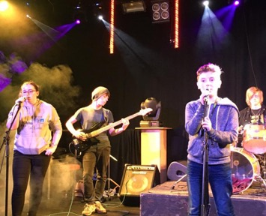
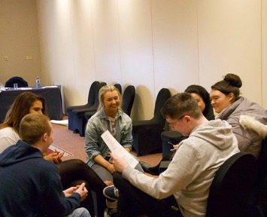
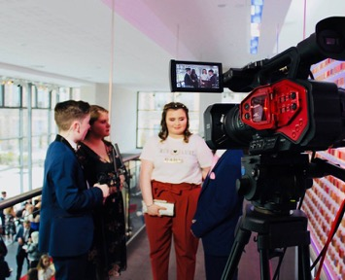
What is Generic/Non-Targeted Funding?
Who is Eligible to apply?
When is the Funding Available?
What can I use the funding for?
Voluntary Youth programmes delivered solely by Volunteers
Funding is Allocated Each Year Through Annual Application
Delivering your volunteer lead youth programme
All Education Authority registered Local youth organisations whose youth work is delivered by volunteers for example, uniformed organisations, church-based organisations, with young people aged 4-25 years.
Funding is for one year and applications will be publicly advertised annually on the EA Funding website. The level of funding available will be based on how many young people attend the provision and the hours/weeks they attend.
You can use this funding for programme costs and a contribution to your running costs.
Full information around Eligible
and Ineligible costs can be found
at:
Terms and Conditions Here

Slide 7

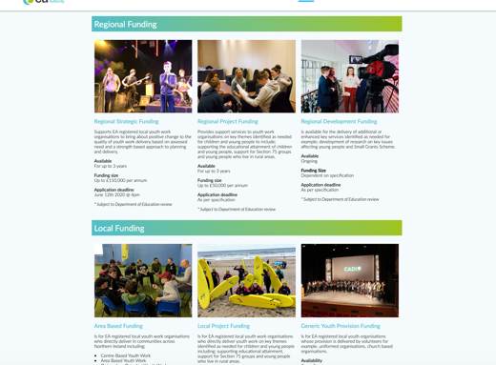
More info on all Funding
Dedicated
Youth Service
Funding
Website
More detailed information about all our funding schemes is available online at
www.eanifunding.org.uk

Slide 8
Registration and Application Process 2024-2025
STAGE | What You Need to Do
1 | Complete your annual re-registration or register for the first time with the Education Authority.
2 | If you are a NEW organisation, you can then skip to Stage 3 If you are currently in receipt of Generic/Non-Targeted Funding for 2023-2024, complete your annual report and upload your completed income and expenditure report on the funding portal.
3 | Complete your Online Application Form for Generic Non-Targeted Funding through the online Funding Portal.

Slide 9
Stage 1 – Registration with EA
For First Time Registrations or Annual Registration

Slide 10
How to Register with the EA Youth Service
Step | Not Registered with EA
1 | Prepare the documents you will require for registration such as safeguarding policies, governing document (both available at www.girlguidingulster.org.uk website in the resources section) and bank account information.
2 | Request an Online Account for Our Funding Portal (Ensure this is done more than 48 hours before 18th May deadline) (Visit www.eanifunding.org.uk and select “Register with EA” to begin the process)
3 | Once your portal account has been issued, complete the Online Registration Form ensuring all questions are answered and applicable safeguarding and governance documentation uploaded before signing and submitting.

Slide 11
How to Re-register with the EA Youth Service
Step | Previously Registered with EA
1 | Prepare the documents you will require for registration such as safeguarding policies, governing document (both available at www.girlguidingulster.org.uk under the resources section) and bank account information.
2 | Log on to your online account (Visit www.eani.smapply.org)
3 | You will be prompted to update your registration form before you can continue to access the current funding opportunities. Changes to this form are outlined later in the presentation.

Slide 12
What information will I need to provide on the registration form
Form Section | Information Required
Registration Type | You will first be prompted to select your registration type, as this guidance is for Local Voluntary Youth Organisations you will select this option.
Organisation Information | Name of unit as registered with bank and meeting place of unit.
Nominating a Regional Voluntary Youth Organisation (RVYO) to provide you with support | Select Girlguiding Ulster in the drop down box.
Governance | Here you will select your governance type – Unincorporated Association, provide CCNI number (if applicable), upload your governing document (Girlguiding Ulster constitution) and provide the names and email addresses of your Chairperson, Secretary and Treasurer (This can also be equivalent of these roles for your organisation e.g. unit leaders/District Commissioner etc).
Membership & Volunteer Information | In this section you will provide breakdown of your current membership by the outlined age bands, and numbers of volunteers.
Safeguarding and Health and Safety Information | A requirement of registration is that all organisations provide their most recent version of their safeguarding policy. You will only need to provide this once unless you update it next year. In addition, organisations are required to declare they have appropriate insurance and health and safety practice in place to delivery programmes with children and young people.
Confirmation you deliver Youth Work in line with DE Policy and Curriculum | EA Youth Service can only fund and register youth organisations who delivery youth work in line with the Model for Effective Practice and DE Policy Priorities for Youth. Organisations will be required to declare this is the case on their registration form.
Bank and Accounting | You will provide your bank account information and declare that your bank account is in the name of the organisation and there are at least 2 signatories on the account.

Slide 13
Organisation Details
Once submitted, this information cannot be edited without contacting youthfunding@eani.org.uk.
Name of Organisation
Leader in Charge Name
Registered Address of Premises
Local Area Council |  | Postcode
Contact Telephone
Website Address (if applicable)

Slide 15
Document upload

Slide 16
Committee / Board Details
Please provide the details of those holding the positions below, or the equivalent for your organisational governance e.g. director. The email address provided here will be used for correspondence regarding funding award outcomes or communication from the funding portal. Multiple office roles cannot be held by the same individual. Email addresses should only be accessible to the person named and cannot be a generic email address (e.g. info@123.com). The Education Authority must be informed in writing of any changes to this information by emailing youthfunding@eani.org.uk. All correspondence will be issued to the Chairperson and Honorary Secretary of the organisation and their email addresses will be shared with your nominated Regional Voluntary Youth Organisation, if applicable.
Role | Title | Full Name | Email Adress
Chairperson
Honorary Treasurer
Honorary Secretary

Slide 17
Safeguarding
Youth Groups must submit a copy of their child protection policy. Your Child Protection policy must outline procedures for recruitment and criminal record background checks in line with DE Guidance.
Groups are advised that it is an offence to knowingly employ a person who has been disqualified from working with children and young people.
Guidance on what is required in a child protection policy for registration with EA can be found here.
Document upload

Slide 20
Stage 2 – Completing End of Year Report 2023-2024
If currently in receipt of 2023-2024 Generic/Non-Targeted Funding
If you are a
new
Organisation you can Skip this stage!

Slide 21

Annual Report
If your organisation has been in receipt of 2023-2024 Generic Non-Targeted
(GNT) Funding from the Education Authority you will not be able to apply for 2024-2025 funding until you submit your Annual Report through the funding portal.
Once your organisation has registered and the annual report and completed income and expenditure form has been submitted, you can then create a
new GNT application for 2024-2025 on the funding portal.
Report Section | What will I need to Provide
Membership Breakdown | Provide the numbers of young people by age band for your registration period of 2023-2024.
Engagement Framework Information | Provide the number of young people per stage on the engagement framework based on your membership.
Actual Funding Used | Provide details of how much of your funding award in 2023-2024 you spent.
Income and Expenditure | Upload a copy of your completed income and expenditure report (provided with your letter of offer and available on the EA website) for the 2023-2024 period.
All reports are subject to an EA Verification check, and we may request your original receipts. These should be retained for Auditing purposes.
Play Demonstration Film – How to Complete Your Annual Report

Slide 22
Income and Expenditure Form (I&E)
The template can be found on the EA website along with the Terms and Conditions for Use of Generic Non/Targeted Funding – EANI Funding All information must be completed in full to include Payee Supplier Name, Invoice date, Invoice number or Receipt, Item Description and Total Cost, making sure you also include Youth Club Name and amount of funding received. At the bottom of the I&E form, detail the total expenditure, underspend if applicable, sign and date.
Education Authority - Income and Expenditure Claim Form
Schedule of Payments by Budget Heading
Youth Club Name |  |  |  | Cost Centre
Funding Strand | Generic/Non-Targeted |  |  | URN NUMBER
Total Funding received | £
Claim Period | 01/4/2022 to 31/03/2023
ELIGIBLE GENERIC/NON-TARGETED COSTS - Please ensure you reference the Terms and Conditions booklet that was sent with your letter of offer before completing the below as anything submitted on this form that is ineligible will be disallowed
If this form is not fully completed with the information required below, it will be returned to your organisation, and this will delay payment of future funding.
Organisaton to complete | Organisaton to complete | Organisaton to complete | Organisaton to complete | Organisaton to complete | EA Office Use only verification | Formula do not override
Payee Supplier Name – Who the goods were purchased from | Invoice Date dd/mm/yyyy | Invoice Number or Receipt | Item Description - Please ensure you give adequate details of the items purchased. | Total Cost (Incl. VAT) | EA Vouched | EA Not Vouched
 |  |  |  |  |  | £0.00
 |  |  |  |  |  | £0.00
 |  |  |  |  |  | £0.00
 |  |  |  |  |  | £0.00
 |  |  |  |  |  | £0.00
 |  |  |  |  |  | £0.00
 |  |  |  |  |  | £0.00

Slide 25
Stage 3 – Completing a 2024-2025 Application
For Generic Non-Targeted Funding

Slide 26
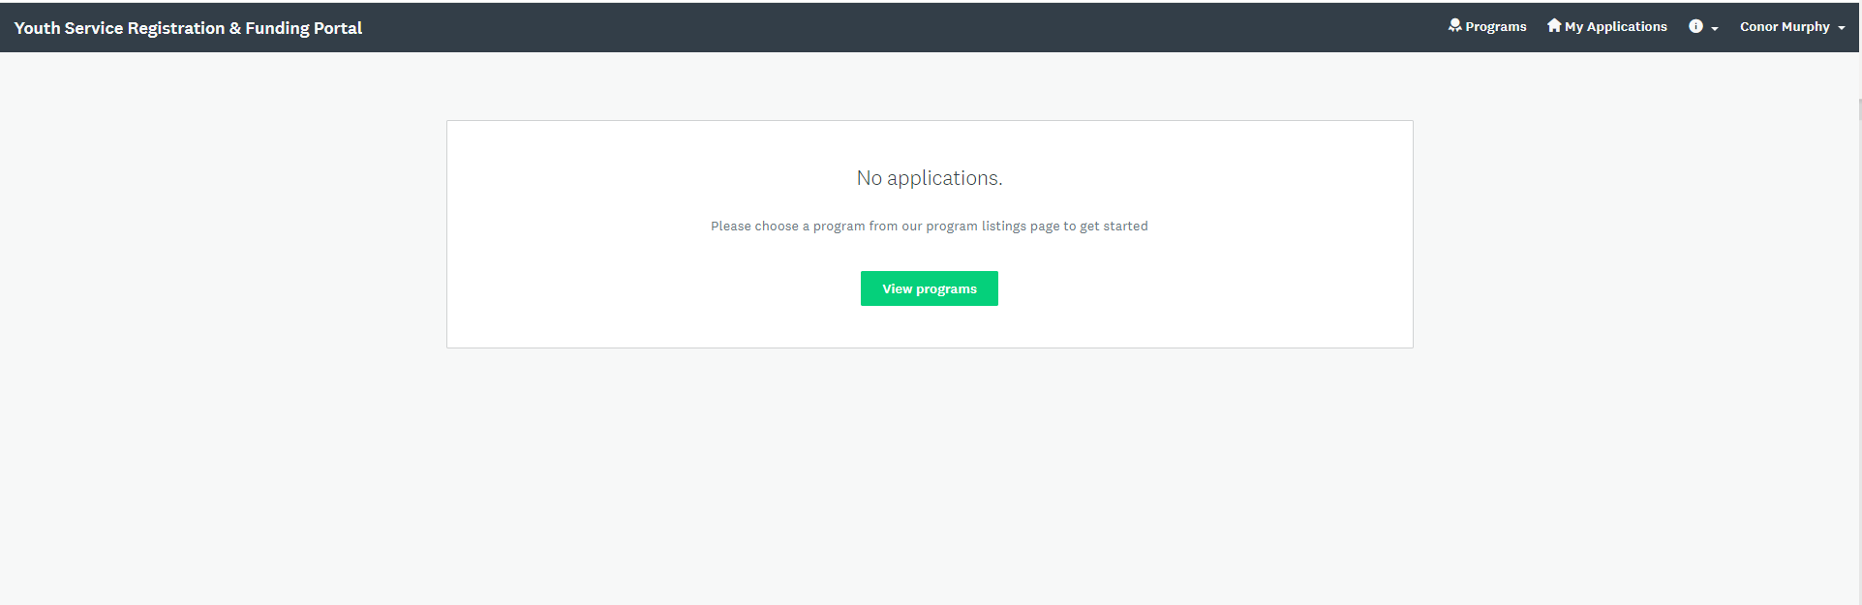
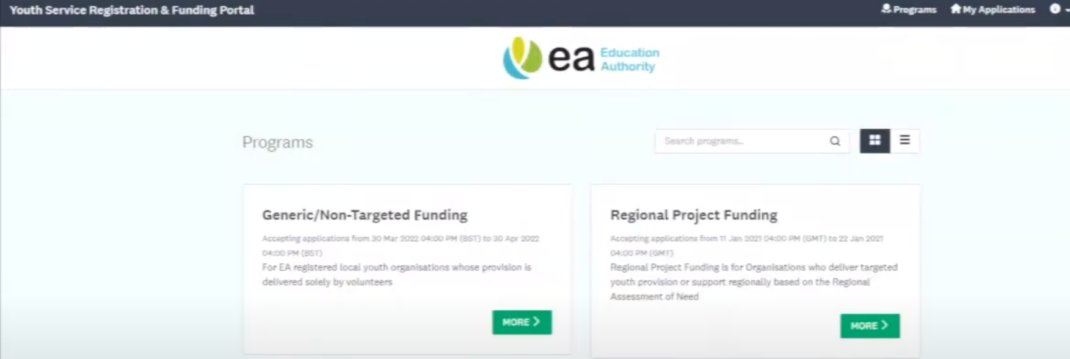
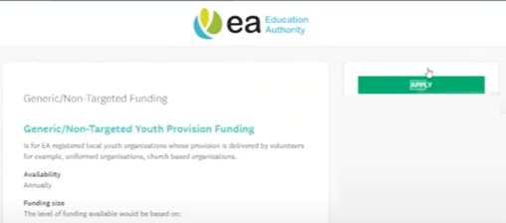
How to create a new Generic/Non-Targeted application
1. Go to the “Programmes” page by selecting this icon.
2. Go to the “Generic/Non-Targeted Funding” page by selecting this icon.
3. Open an application by selecting the “Apply” icon.

Slide 27
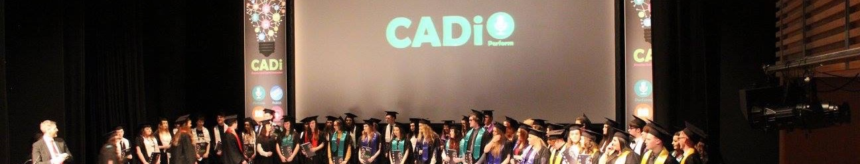
Generic/Non-Targeted Application 2024-2025
If you are a newly registered organisation or you have just completed your annual report for 2023/24, you can select the Generic/Non-Targeted funding Stream and start a new application for 2024-2025 through the funding portal.
Question | Descriptor
Total weeks of programme provided per year | Simply state how many weeks per year your programme is delivered for young people.
Programme Overview | This will be in the form of a table that asks for your days of provision, section/age group, number of hours and average attendance.
All other details required will be taken from your registration form so you do not have to provide it again here.
Day/Night of the Week | Age group | Operating Times | Sessional Hours | Sessional Attendance
Monday | Age 4-8 | 5.30pm to 7.00pm | 1.5 | 45
 | Age 9-13 | 6.30pm to 8.30pm | 2 | 30
 | Age 14-18 | 7.00pm to 9.00pm | 2 | 15
All applications subject to an EA Verification Check and we may visit or contact you to verify the accuracy of information provided on your application form as part of our Audit Process.

Slide 28
Application, Assessment & Award Timeline
For 2024-2025 Generic Non-Targeted Funding

Slide 29
Application, Assessment & Award Timeline
Payment to groups accounts
subject to any outstanding
returns or queries for all EA
Youth Service funding being
satisfied
Registration and Application for Generic Non-Targeted Funding Opens
17th May
30th June
By 31st July
Application Assessment Begins
Acceptance of Formal Letter of Offer
Applications for Generic Non-Targeted Applications Close
Notification of 2024-2025 Funding Award
Payment to Groups Accounts
8th April
20th May
9th June
Within 28 days of your letter of offer being issued
Registration will continue to remain open all year round. Any organisation registering from this point cannot apply for GNT Funding for 2024/25.

